Slide 1
Welcome!

Slide 2
Mayor’s Message

Slide 3
Agenda
Motion for approval

Slide 4
Motion for Approval:
Minutes of the 2022 AGM

Slide 5
President’s Message
“Growth is never by mere chance; it is the result of forces working together.”
James Cash Penney, founder of JC Penney

Slide 6
2023 - The Year in Review
Marketing, Promotion and Communication:
Increased social media captures via Facebook and Instagram. Use of standardized branding and creative campaigns to promote businesses and events, including an event calendar added to the website.
Allocation of a budget for paid social media
Presented a delegation to the new Council to overview 2023 objectives
Developed an online Visitor survey to capture valuable data
Coordinated the Snowflake Festival 2023 on Family Day
Regular communications to the community via Chamber Chat in the Phoenix, as well as regular Newsletters to the Membership
Production of annual Business Directory/Map at Merrickville Square
Struct a sub-working group to Refresh the 4 Entrance signs
Reactivation of Business Recognition Awards
Partnership:
With the Municipality and the Lions to achieve the Business Friendly Business Area designation with Ontario by Bike
With Friends of the Rideau to provide free WiFi at the Depot
Victorian Style Post Project - ongoing project in partnership with the Municipality
Created a Welcome package for new residents - available at the Municipal Office
With Agribusiness sector to create a Farm to Fork map
Advocacy activities: letters sent to Mayor and Council outlining concerns regarding:
Need for a policy regarding road closures during special events
Consistent Event planning procedures
Review of Sign By-Law
Recognition of the diversity of our Community- Flag Policy

Slide 7
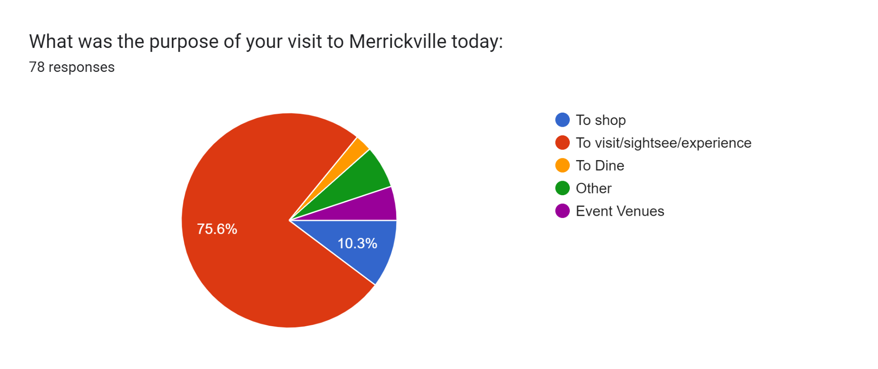
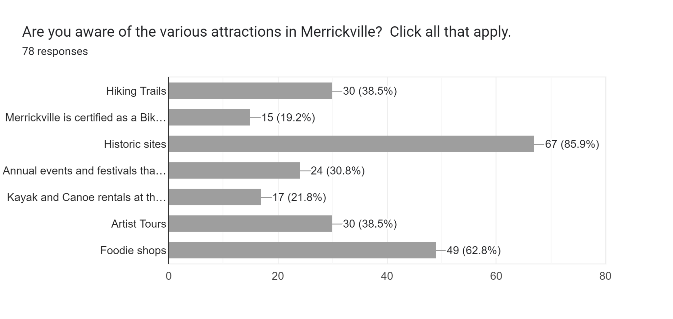
How could we improve your experience
More public and accessible washrooms
A number of Positive comments
Longer, consistent hours (staying open later on Sundays)
More food
More advertising/more signs
Benches
Street music
Key Results from the 2023 Visitor Survey

Slide 8
Merrickville’s Makers Market Survey Results
 | Where did you Visit from? | Did you check out other Merrickville Businesses? | How did you hear about our Markets? | How much did you spend today in Merrickville?
Spring 994 attendees N=127 | Majority from Merrickville, Kemptville | Over 85% said YES | 48.8% Facebook 36.2% word of mouth | 60.6% spent <$100 34.6% between $100 - 250
Fall 1200 attendees N=36 | Majority from Merrickville, Smiths Falls and Kanata | 80.6% said YES | 47.2 % Facebook 25% word of mouth | 55.5% <$100 41.7% between $100 - 250
Winter 2,600 attendees N=73 | Majority from Kemptville, Ottawa, Merrickville and Brockville | 94.5% said YES | 58.9% Facebook 32.9% word of mouth | 45.2% <$100 50.7% between $100 and 250

Slide 9
Treasurer’s Report
Motion for approval

Slide 10
Finances for 2023
Fixed & Discretionary Expenses:
$11,210.61
Rental of storage unit
We supported 14 Community Groups/Events providing $2,900
Professional & Accounting Fees
Advertising, Promo & Marketing
WiFi at Depot for the summer
Website
Insurance
Membership Revenue: $12,037.50
53 Full Members
18 Home-based/Service/Contractors
12 Not for Profit/Associate
For a total of 83 Members

Slide 11
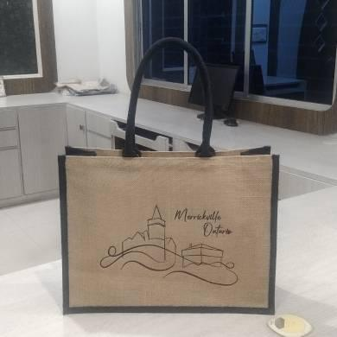
2023 Campaigns
Streetscape Sub-Working Group
We have sold 220 Merrickville branded tote bags, bringing in $3,051 to help beautify our Village
Bags were sold at the Depot, Mrs. McGarrigles, Chaiya Home and Garden and the Village Bean
Refresh of 4 Entrance Signs
Budget: $5,000
Map Advertising
This year we brought in $3,255 in Map Ads and spent $2,175 to produce 5000 maps

Slide 12
Committee Reports and Working Groups & Projects
Committees:
Map - Yves
Marketing, Promotions & Communications Committee - Kate
Networking & Partnership - Robyn, Yves
Membership - Robyn
Working Groups:
Streetscape Working Group
Refresh of the 4 Entrance signs
Projects:
With the Municipality-
Victorian Lamp Posts
Refresh of the Map holder at the Parkette
Public, Accessible Washroom(s)
Update of photo library with L-G United Counties Economic Development

Slide 13
Business Recognition Awards

Slide 14
Q/A Session

Slide 15
Nominations and Election of Directors
Entering 2nd Year of 2 year term | Nominations
Trevor Johnson Pam Watts Yves Grandmaitre Kate Folk | Haley Lachance Gary Decatur Jan Ditchfield
Nomination from the floor (ask 3 times)
Close of Nominations
Call for Vote if required

Slide 16
Closing Words
“Coming together is a beginning; keeping together is progress; working together is success”
- Henry Ford

Slide 17
Adjournment
&
Announcement of the 2024 Board of Directors

